Slide 1
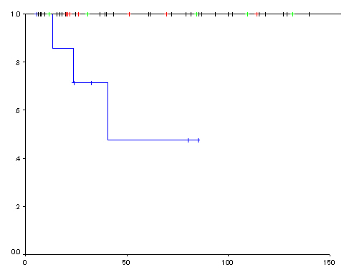
M-SM1 cancer in ER
SM2 cancer in ER
M cancer in surgery
SM2 cancer in surgery
Cause-specific survival rate
P=0.0002
Months

