Slide 1
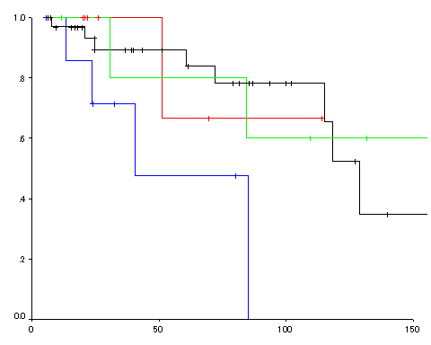
M-SM1 cancer in ER
SM2 cancer in ER
M cancer in surgery
SM2 cancer in surgery
Over-all survival rate
P=0.08
Months

