Slide 1
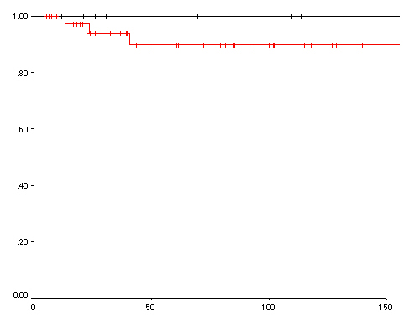
ER group
Sugery group
Cause-specific survival rate
P=0.33
Months

