Slide 1
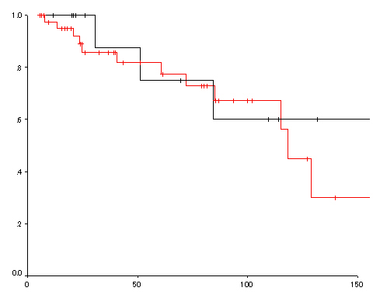
ER group
Surgery group
Over all survival rate
P=0.6
Months

